Slide 1
Packaging Development Study
Summary Charts
June – August 2012

Slide 2
Agenda
Study & Respondent Overview
Packaging & Artwork Performance
Packaging Sustainability
New Product Development Process

Slide 3
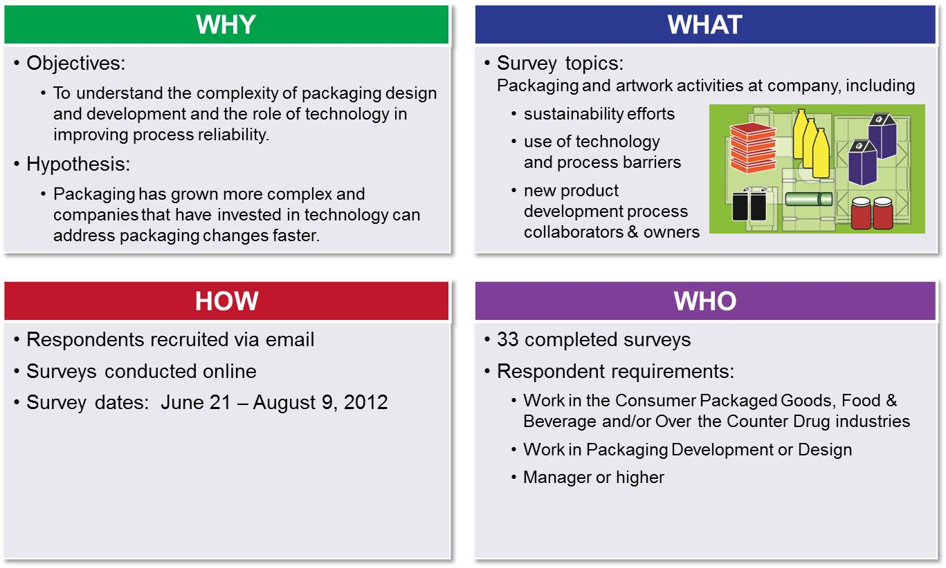
Study Overview

Slide 4
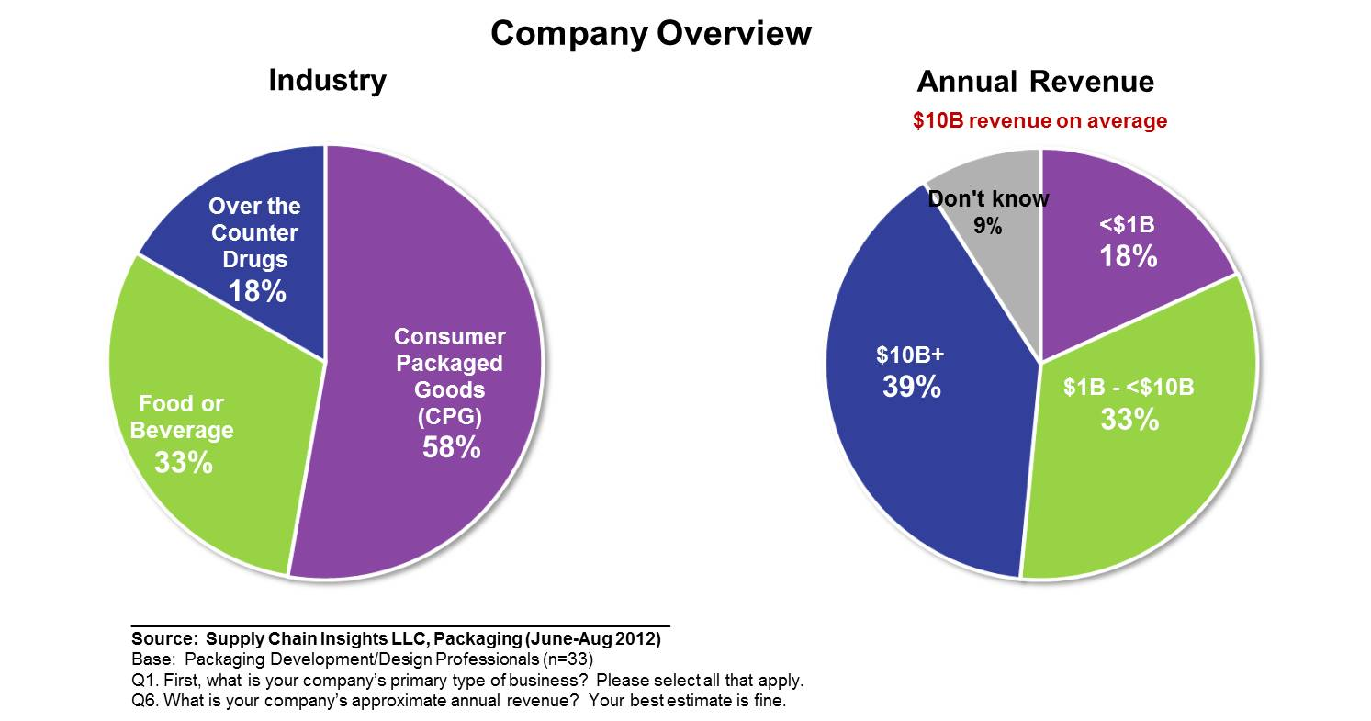
Company Overview

Slide 5
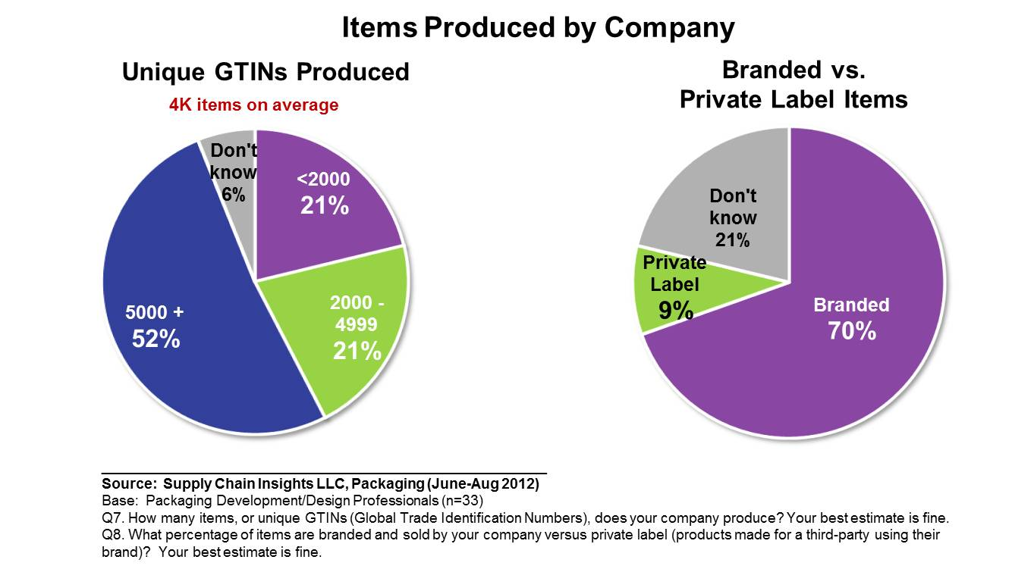
Items Produced by Company

Slide 6
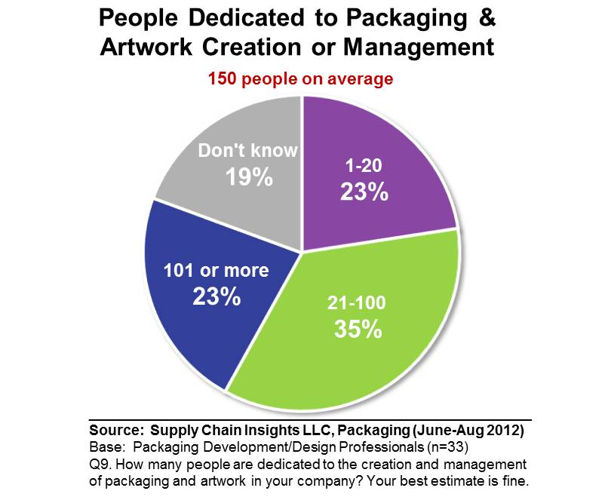
Percent of People Dedicated to Packaging and Artwork

Slide 7
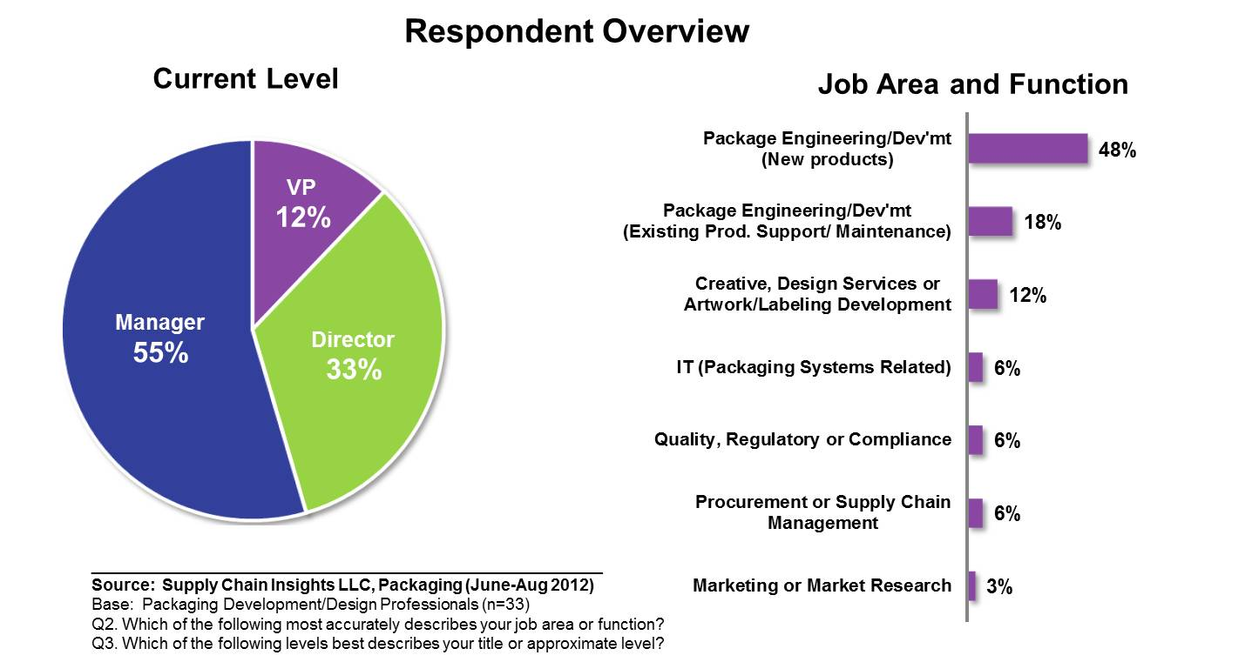
Respondent Overview

Slide 8
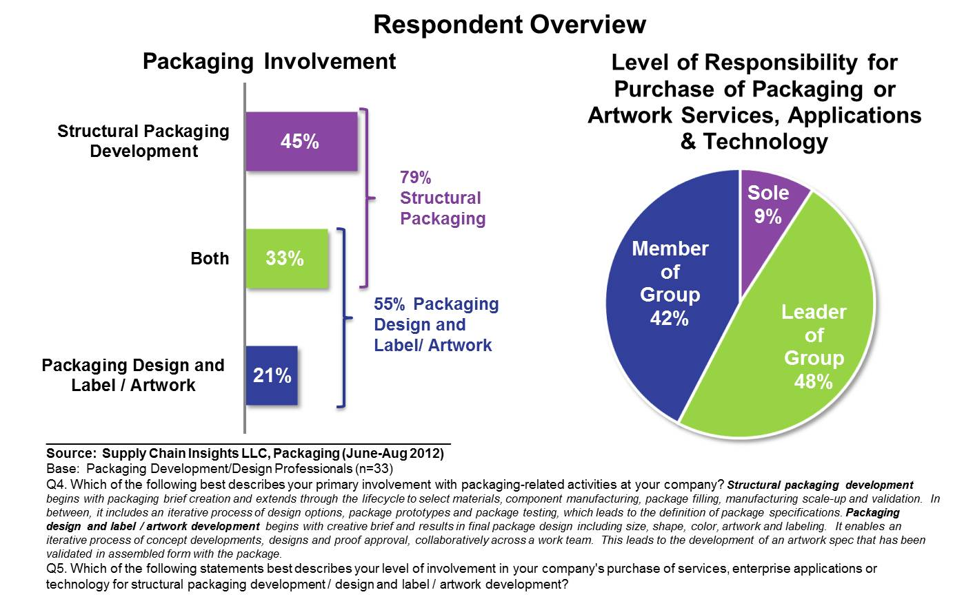
Respondent Overview

Slide 9
Agenda
Study & Respondent Overview
Packaging & Artwork Performance
Packaging Sustainability
New Product Development Process

Slide 10
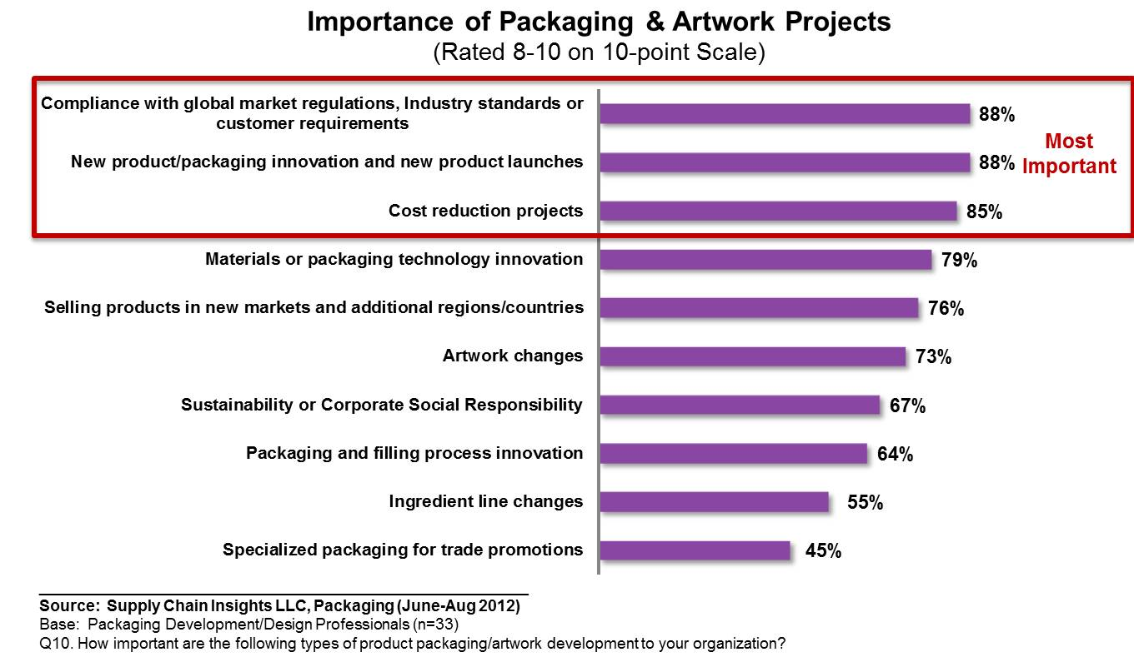
Importance of Packaging & Artwork Projects

Slide 11
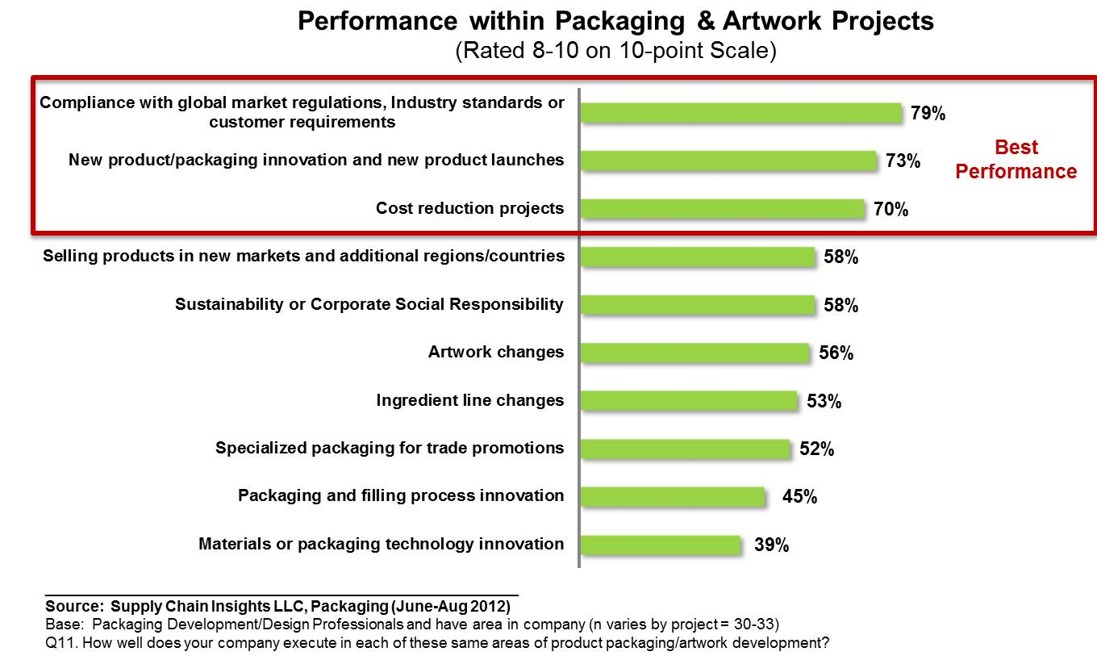
Performance in Packaging & Artwork Projects

Slide 12
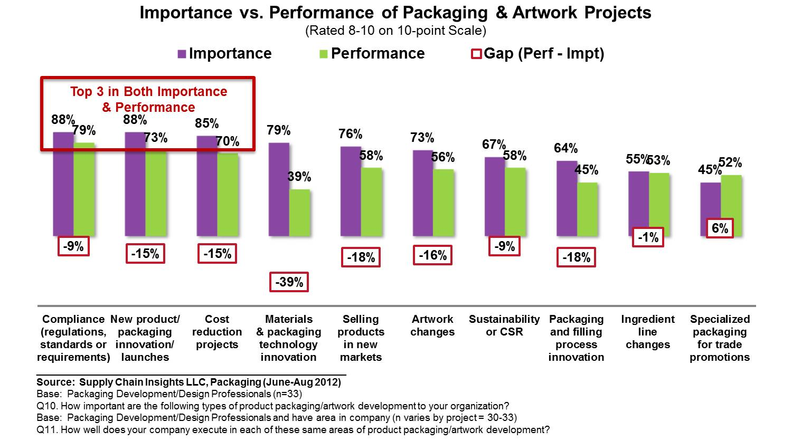
Importance vs. Performance of Packaging & Artwork Projects

Slide 13
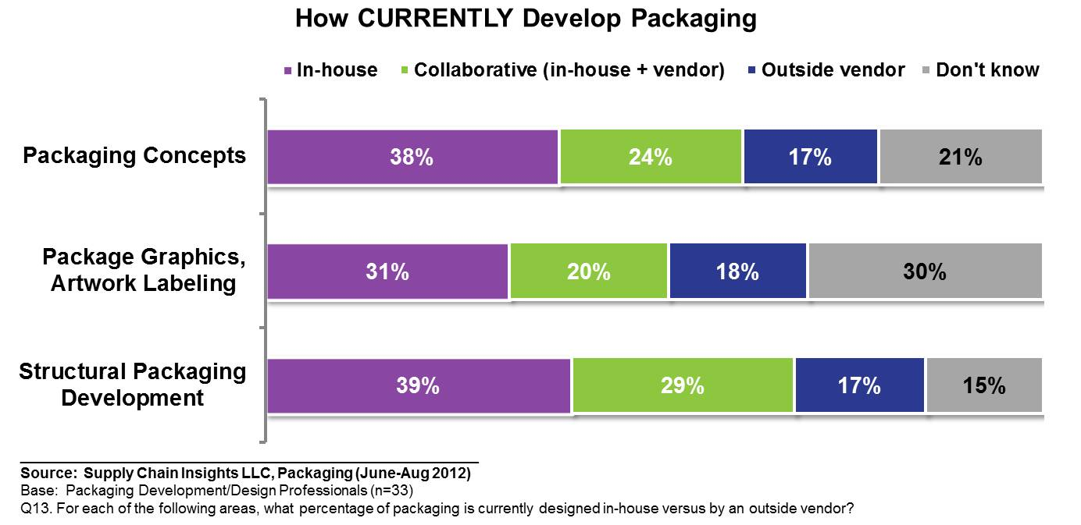
Percent of Packaging In-House vs. Vender: Currently

Slide 14
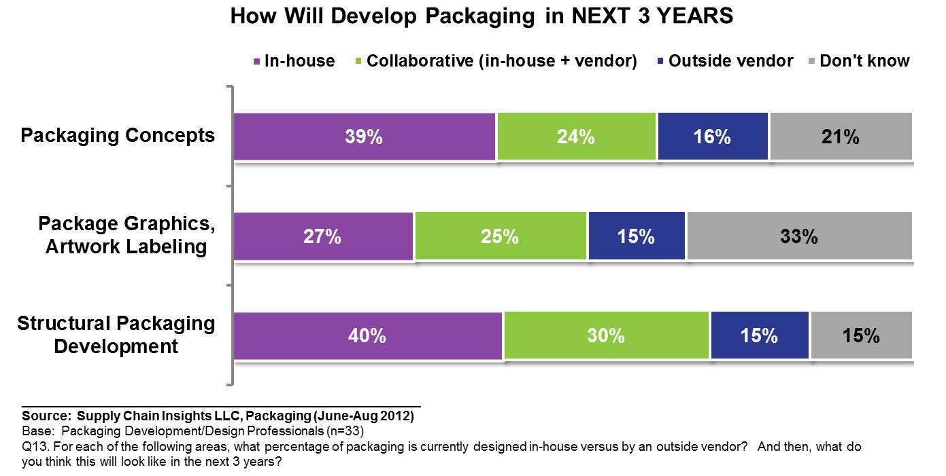
Percent of Packaging In-House vs. Vender: Next 3 Years

Slide 15
Percent of Packaging In-House vs. Vender: Current vs. Next 3 Years

Slide 16
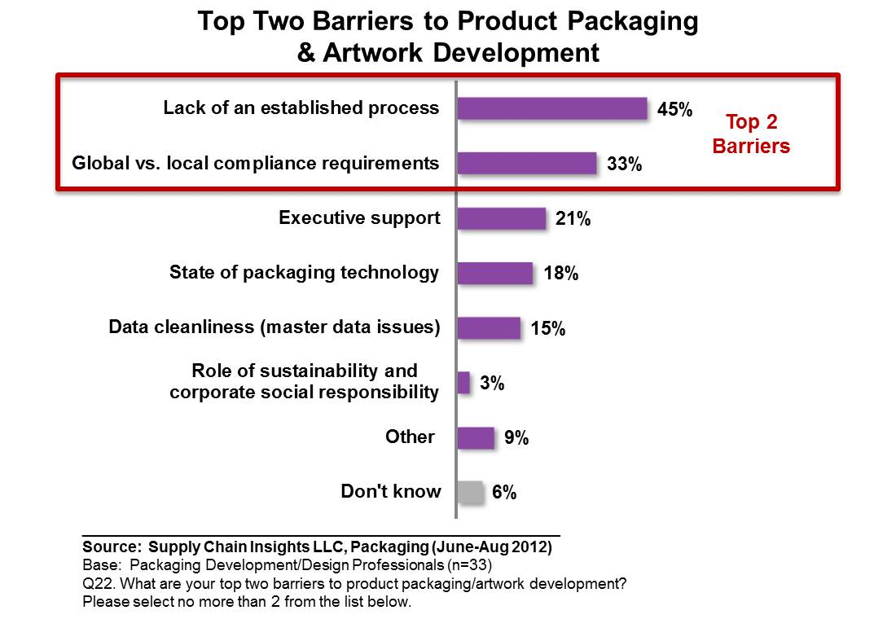
Top Two Barriers to Product Packaging & Artwork Development

Slide 17
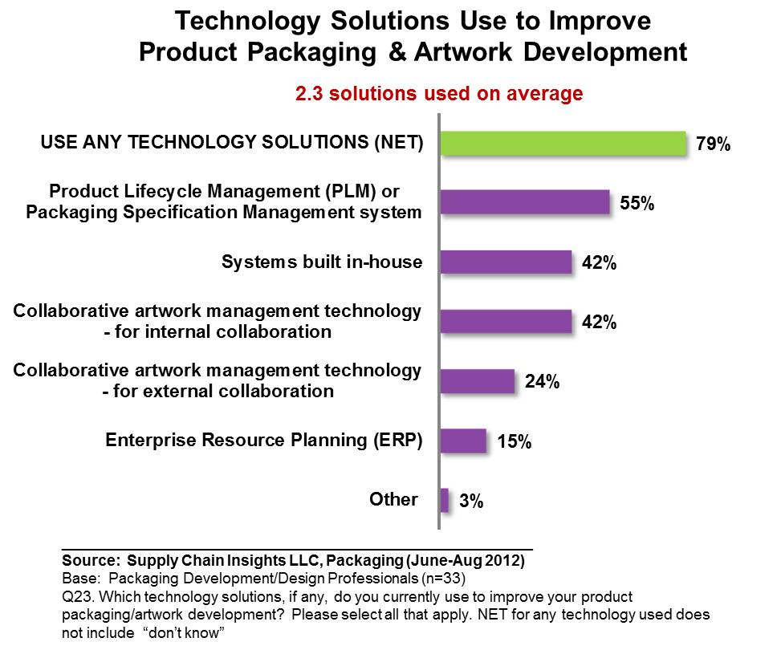
Technology Solutions Use to Improve Product Packaging/Artwork

Slide 18
Technology Features & Functions Needed (Open-Ended)

Slide 19
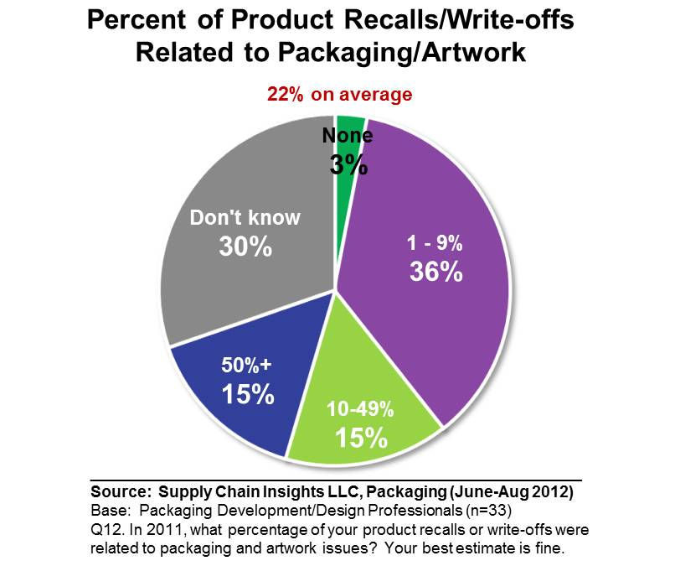
Percent of Recalls/Write-offs Related to Packaging/Artwork

Slide 20
Agenda
Study & Respondent Overview
Packaging & Artwork Performance
Packaging Sustainability
New Product Development Process

Slide 21
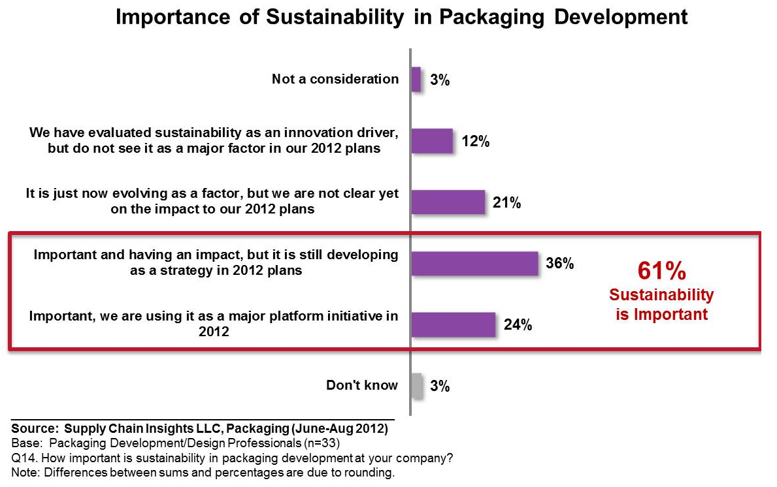
Sustainability Importance in Packaging Development

Slide 22
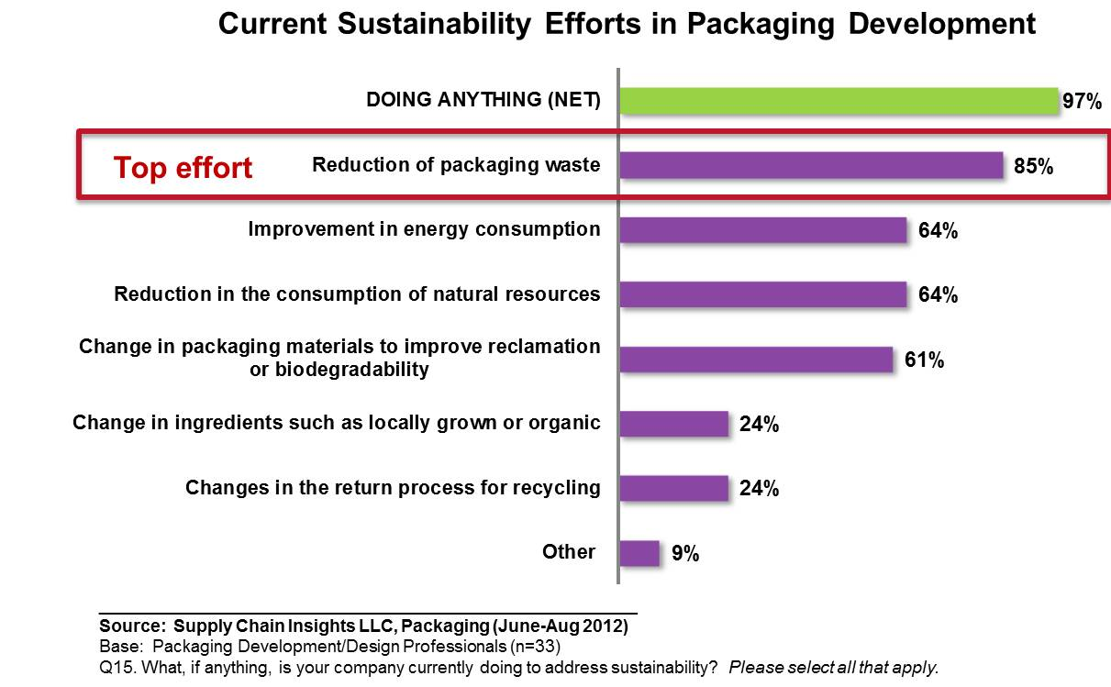
Packaging Sustainability Efforts

Slide 23
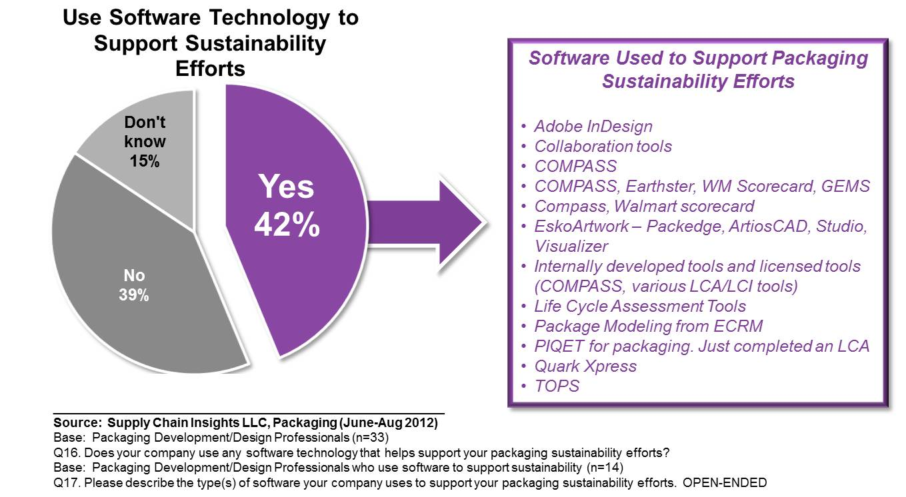
Software Technology to Support Packaging Sustainability

Slide 24
Software Functionality Desired to Support Sustainability (Open-Ended)

Slide 25
Agenda
Study & Respondent Overview
Packaging & Artwork Performance
Packaging Sustainability
New Product Development Process

Slide 26
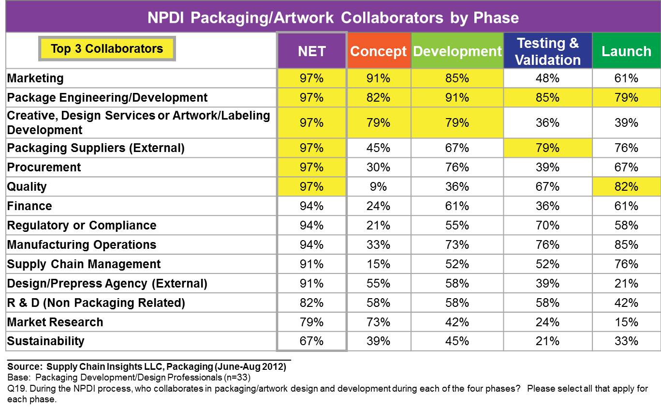
NPDI Packaging/Artwork Collaborators by Phase

Slide 27
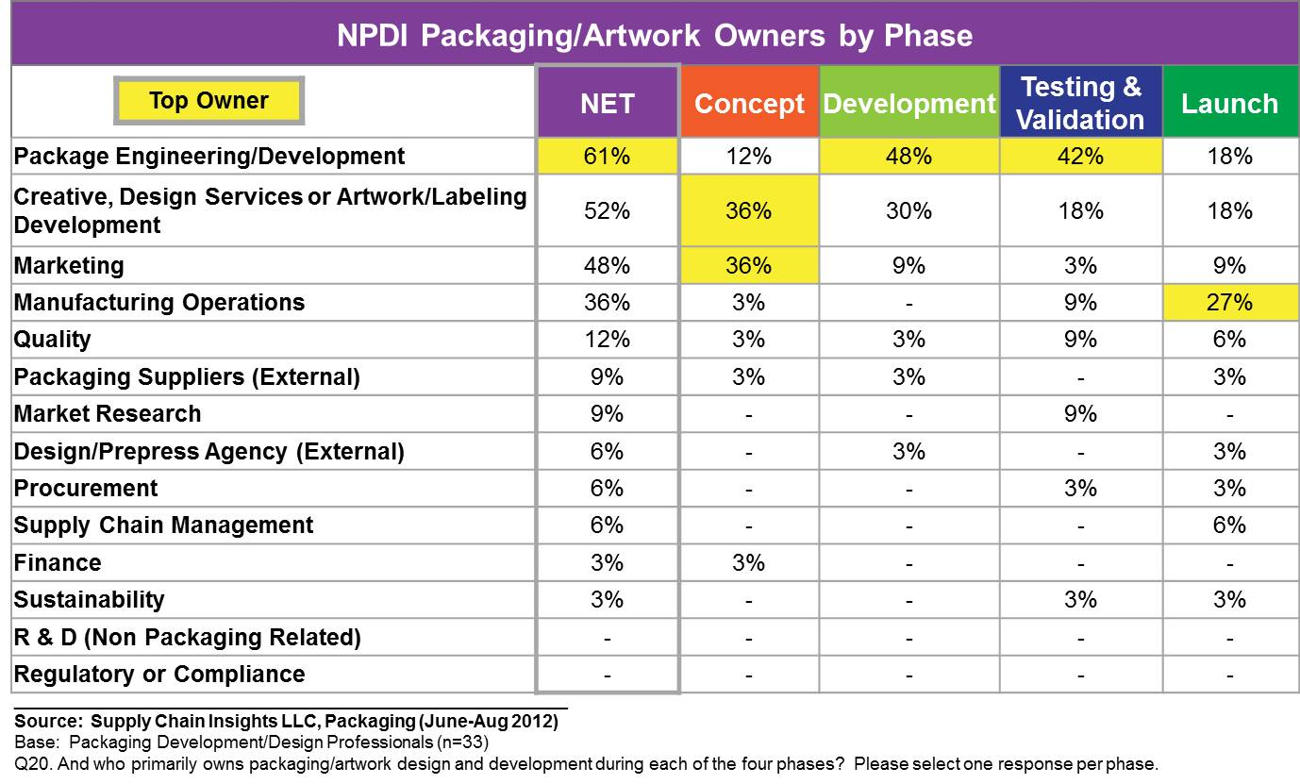
NPDI Packaging/Artwork Owners by Phase

Slide 28
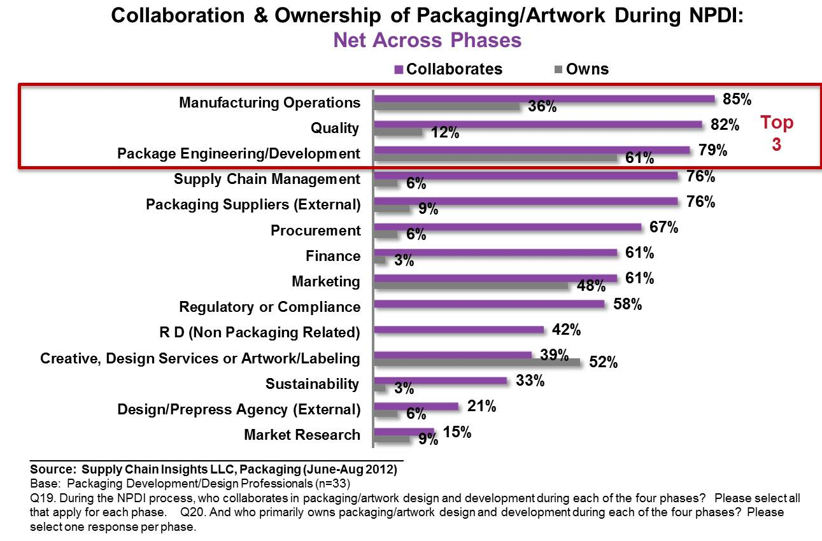
NPDI Collaboration & Ownership on Packaging/Artwork: Net Across Phases

Slide 29
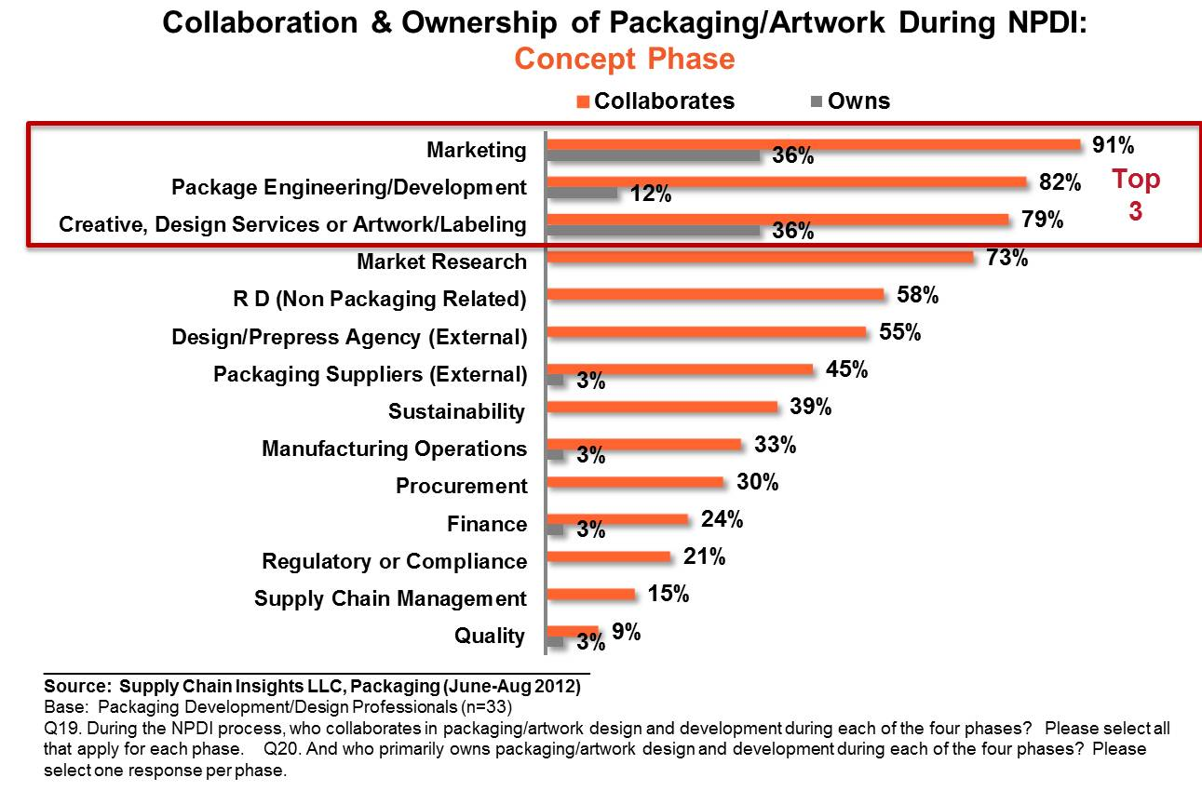
NPDI Collaboration & Ownership on Packaging/Artwork: Concept

Slide 30
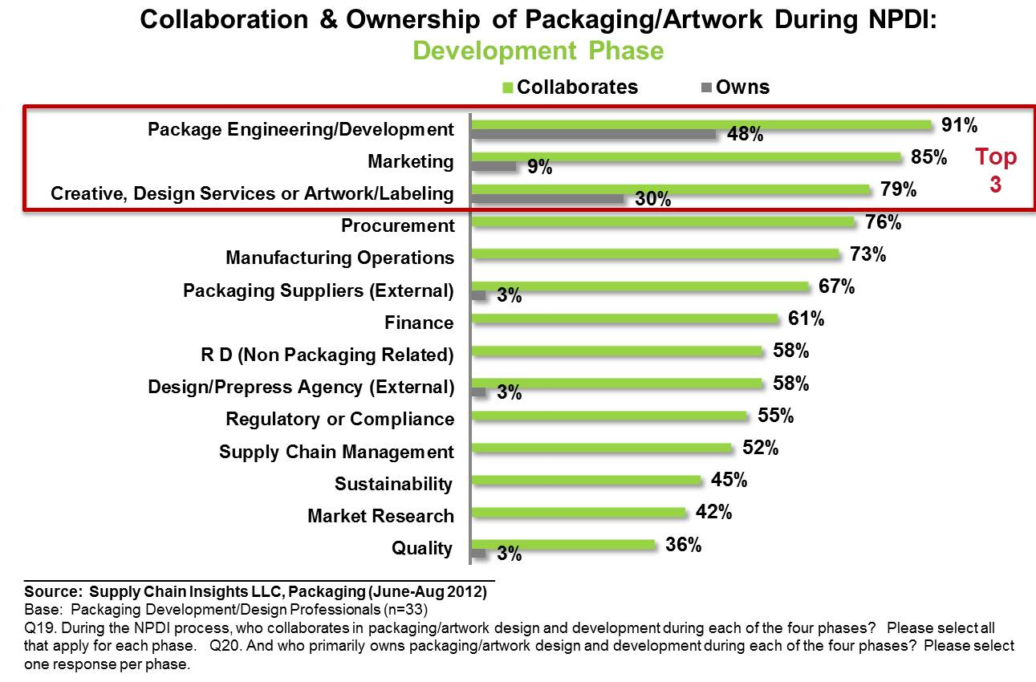
NPDI Collaboration & Ownership on Packaging/Artwork: Development

Slide 31
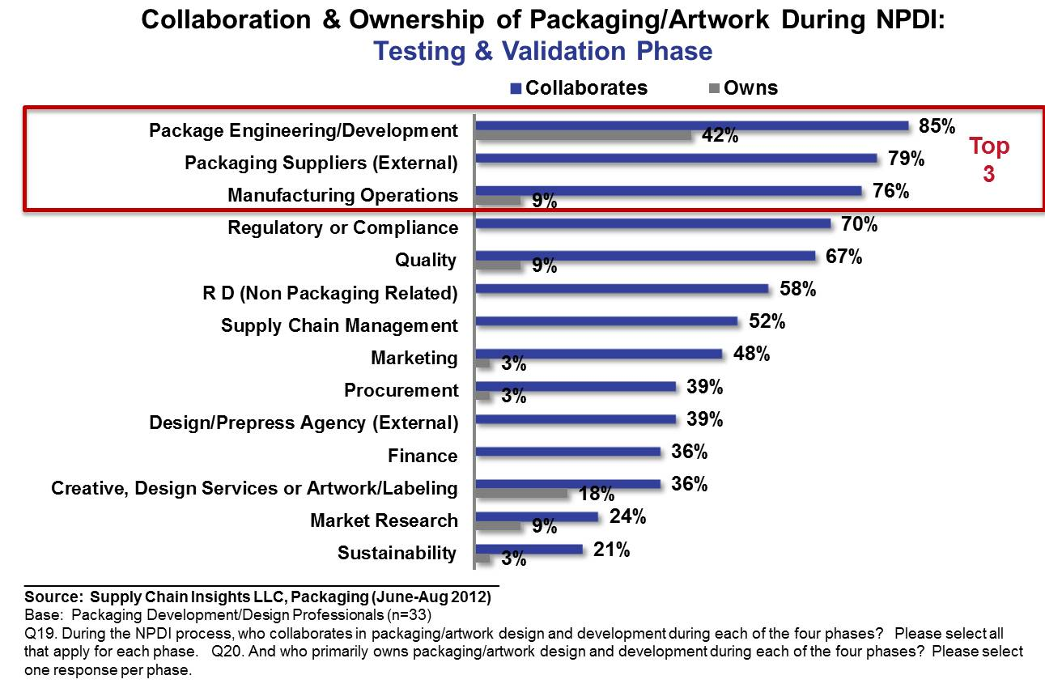
NPDI Collaboration & Ownership on Packaging/Artwork: Testing/Validation

Slide 32
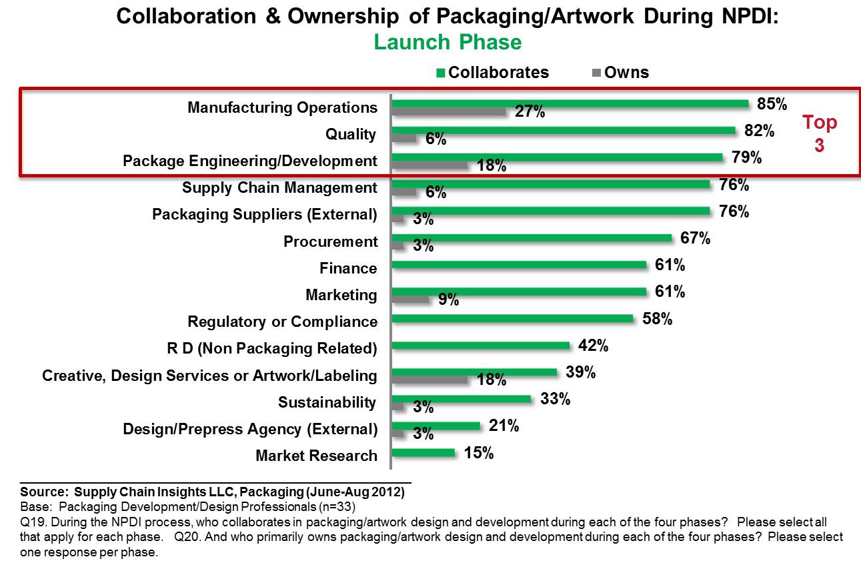
NPDI Collaboration & Ownership on Packaging/Artwork: Launch

Slide 33
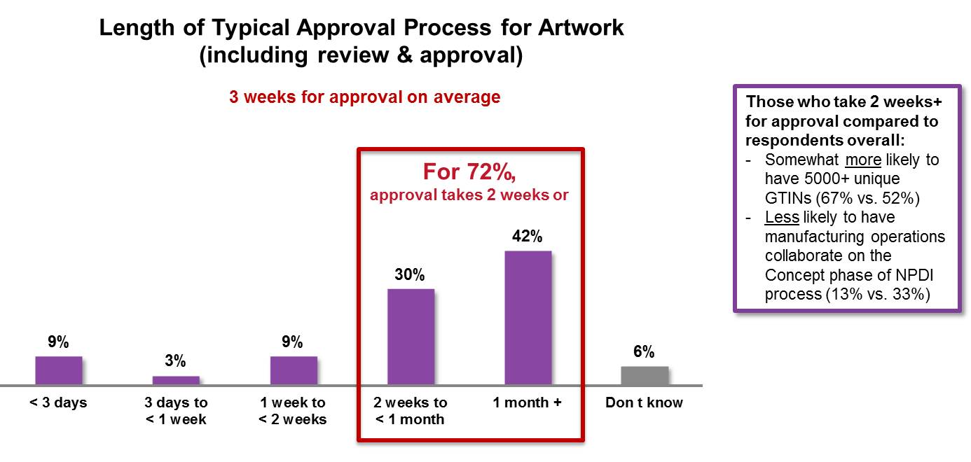
Length of Typical Approval Process for Artwork

