Slide 1
How S&OP Drives Agility
Research Results
March-April 2012
Supply
Chain
Insights

Slide 2
Key Findings
S&OP landscapes are more complex. The average company has five S&OP processes.
There is a gap in supply chain agility importance and performance.
Companies that are the most mature in S&OP are more agile.
90% of companies believe that a mature S&OP improves agility.
Only 13% of companies have effectively tied S&OP planning to execution.

Slide 3
Agenda
Overview
Demographics
S&OP Process
Agility Definition & Goals
Agility Performance

Slide 4
Study Overview
WHY |  | WHAT
OBJECTIVE: To assess the importance of supply chain agility and tactics used to improve agility and to understand the role of S&OP in driving agility in organizations. HYPOTHESIS: The greater the complexity of the supply chain, the more important it is to have a mature S&OP process. |  | Survey topics included: Supply chain organization definition Agility definition and techniques S&OP process details and impact on agility
WHEN & HOW |  | WHO
Online interviews were conducted between March 22 – April 9, 2012. Respondents were recruited via email from Steelwedge. |  | 117 business leaders, primarily Managers and above. Across over 50 companies in 13+ industry groups (primarily Food & Beverage, Make to Order Discrete, Consumer Packaged Goods, and High Tech & Electronics). 62% from Process industries, and 34% from Discrete manufacturers.

Slide 5
Agenda
Overview
Demographics
Agility Performance
Agility Definitions
S&OP Process

Slide 6
Who Was Surveyed? Industry, Company Size & Title
62% Process vs. 34% Discrete

Slide 7
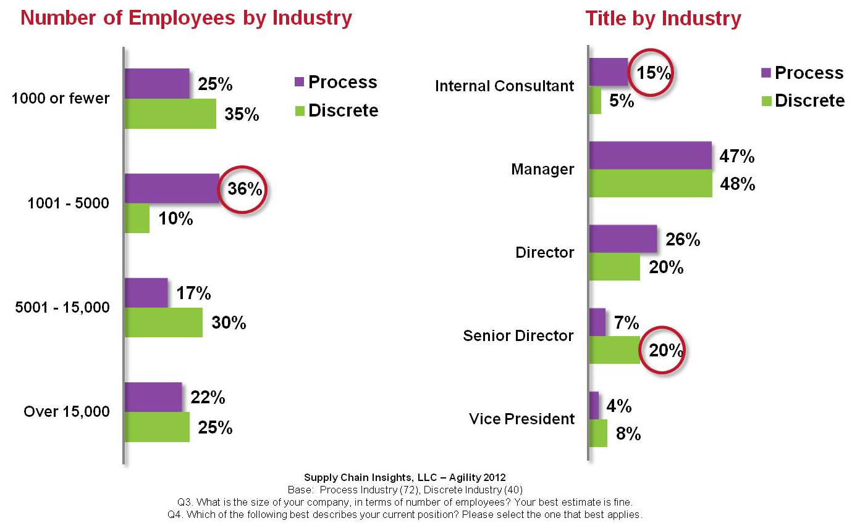
Who Was Surveyed? Company Size & Title by Industry

Slide 8
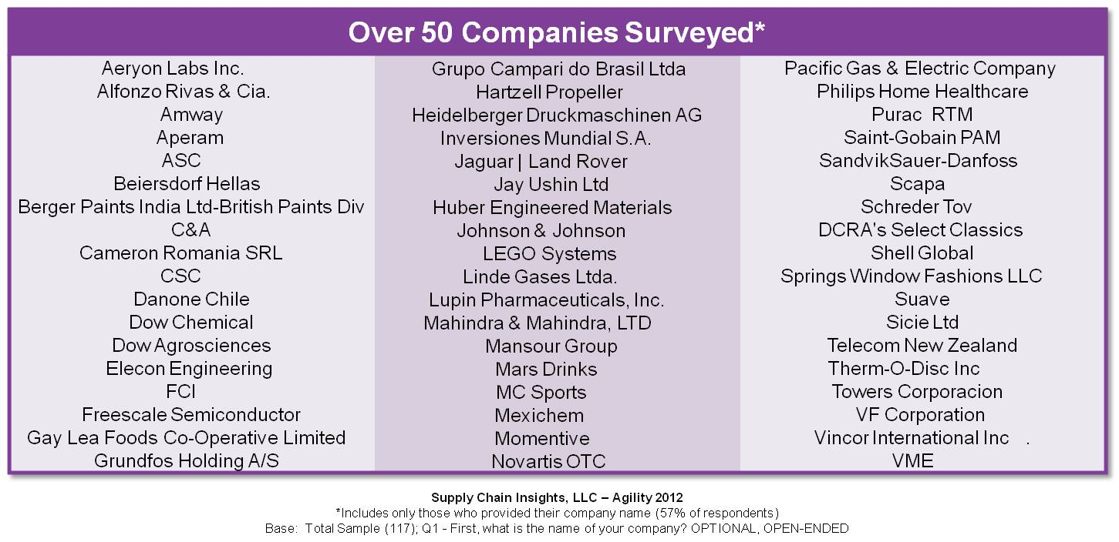
Who Was Surveyed? Companies Included

Slide 9
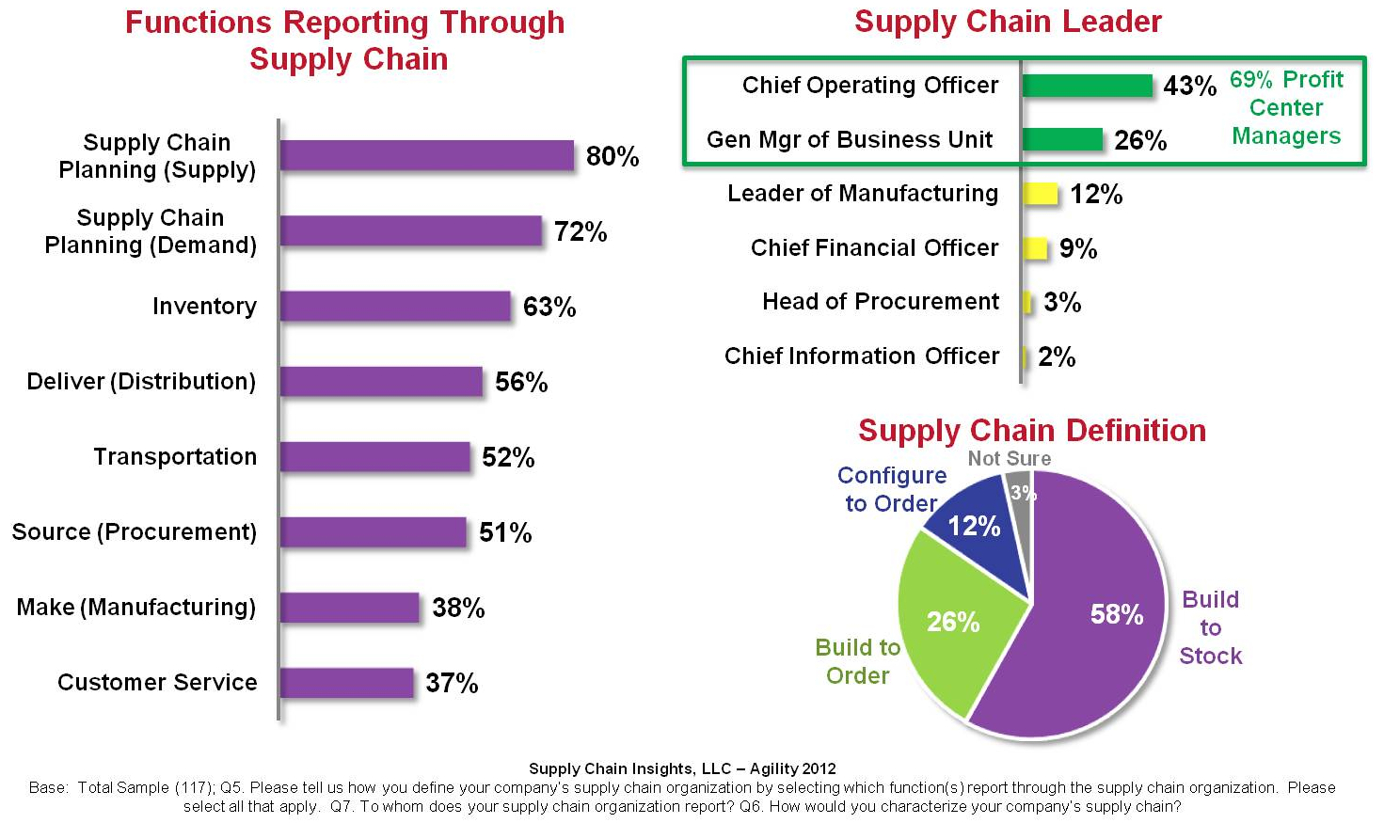
Who Was Surveyed? Supply Chain Organization

Slide 10
Who Was Surveyed? Supply Chain Complexity

Slide 11
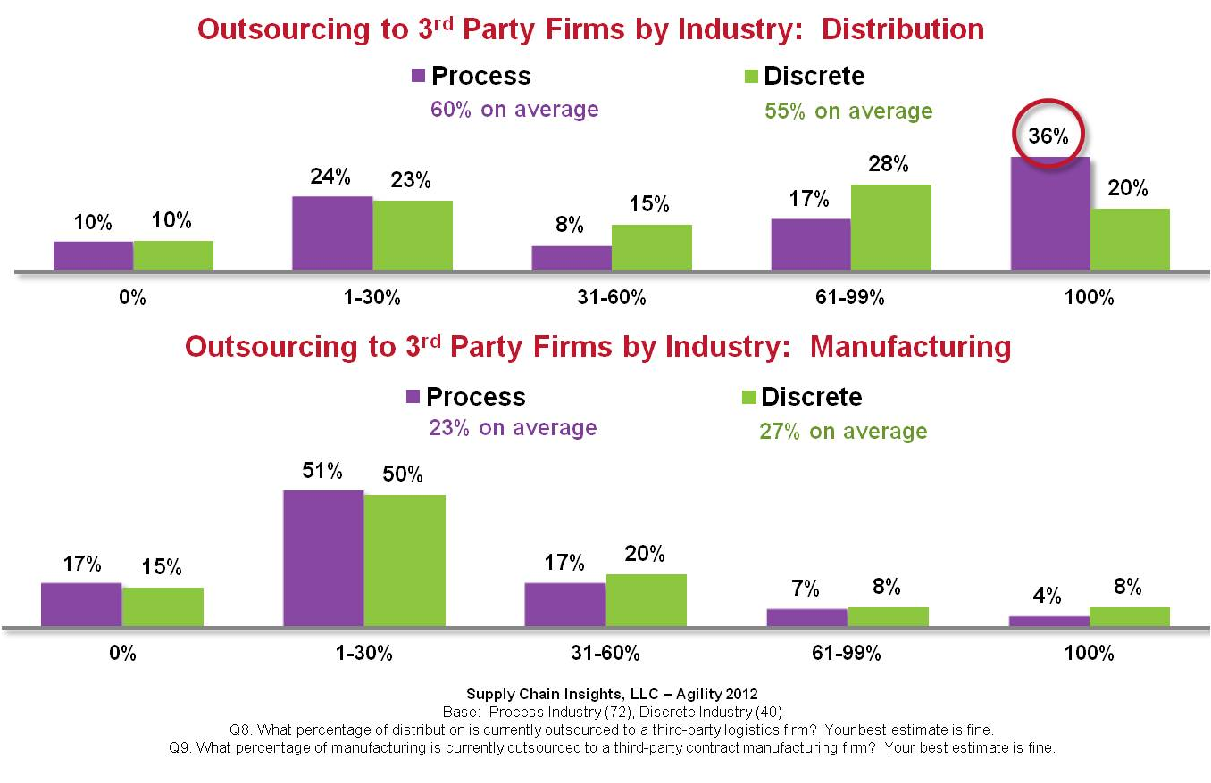
Who Was Surveyed? Supply Chain Complexity

Slide 12
S&OP Process Existence & Processes

Slide 13
Agenda
Overview
Demographics
Agility Definitions
S&OP Process
Agility Performance

Slide 14
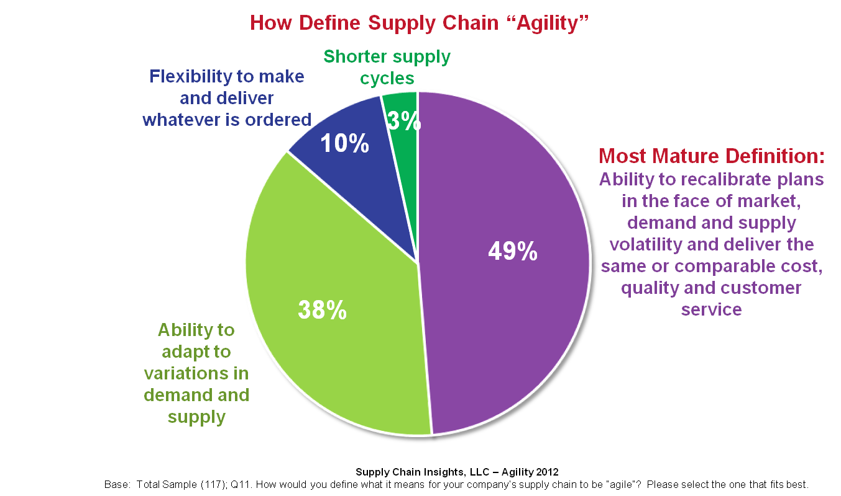
What is Agility?

Slide 15
What is Agility? By Supply Chain Leader

Slide 16
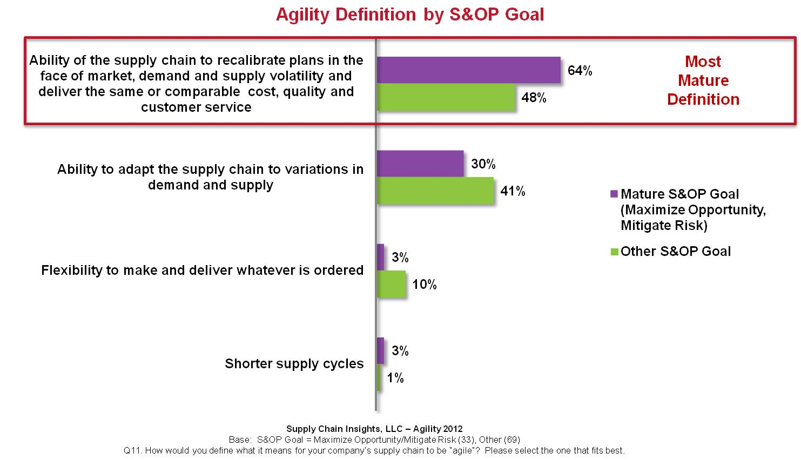
What is Agility? By S&OP Goal

Slide 17
Agenda
Overview
Demographics
Agility Definitions
S&OP Process
Agility Performance

Slide 18
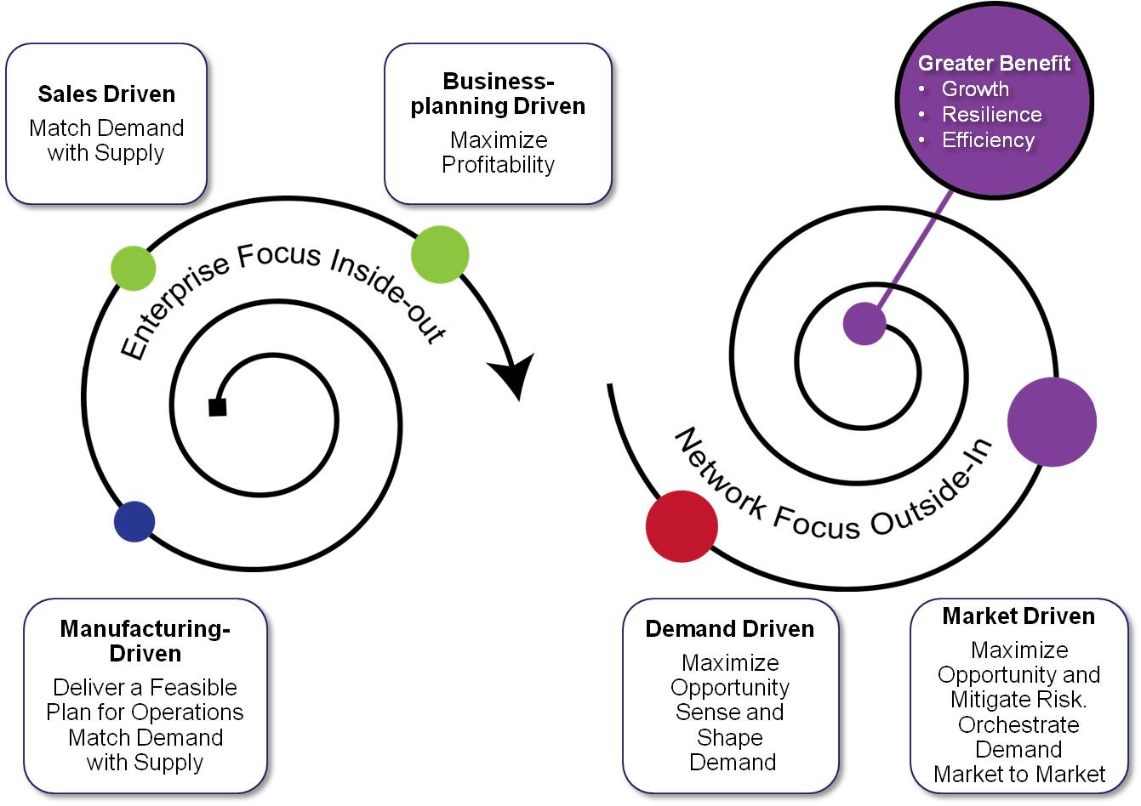
S&OP Evolution

Slide 19
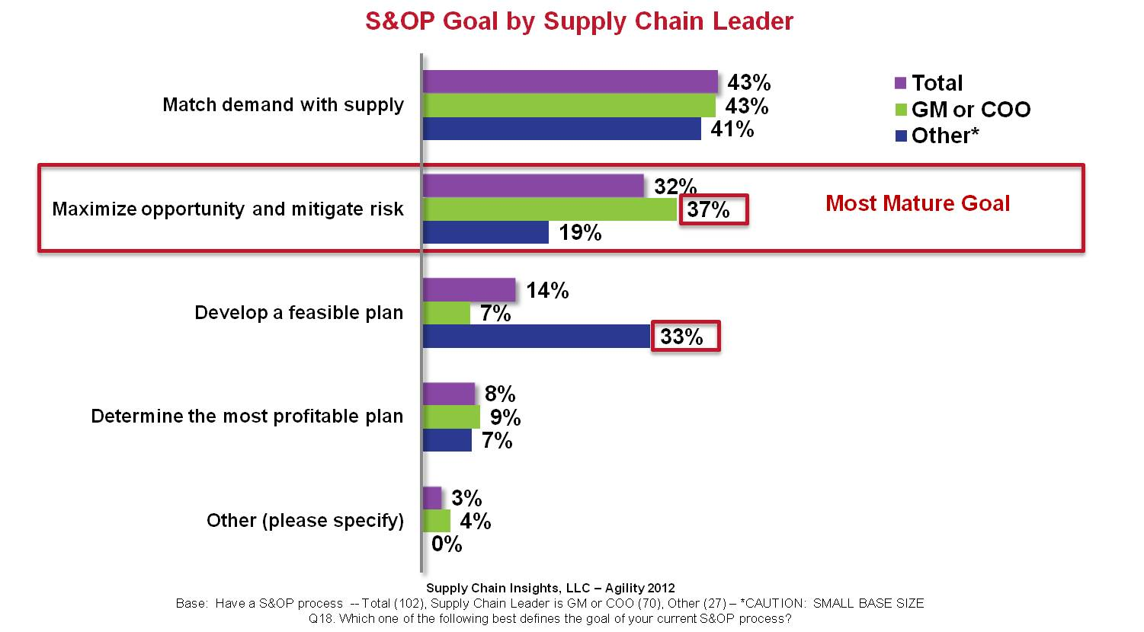
S&OP Goal By Supply Chain Leader

Slide 20
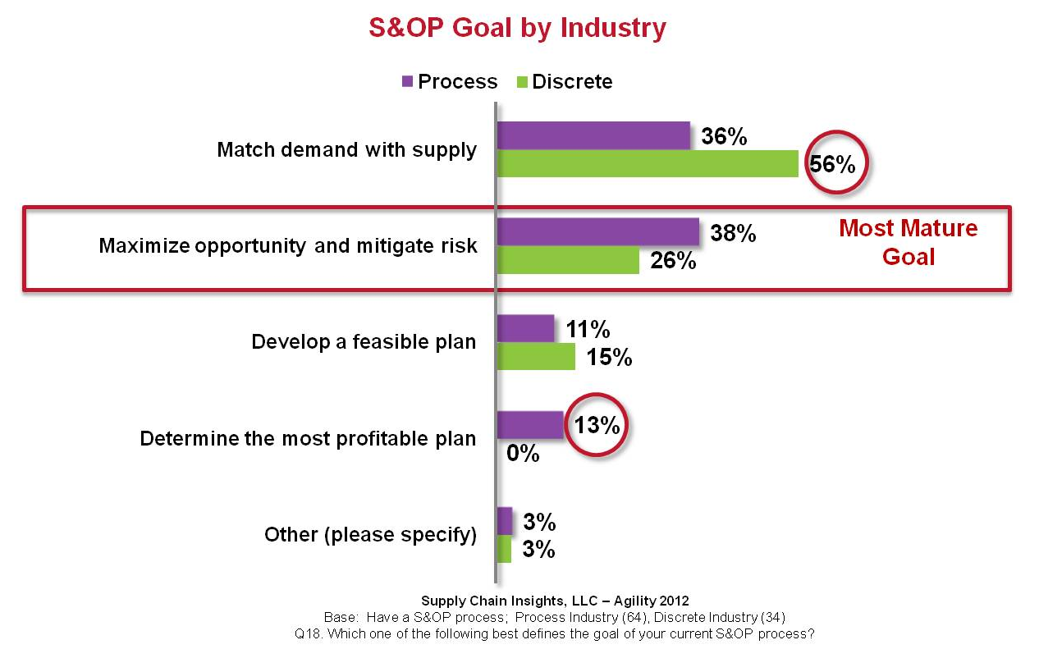
S&OP Goal By Industry

Slide 21
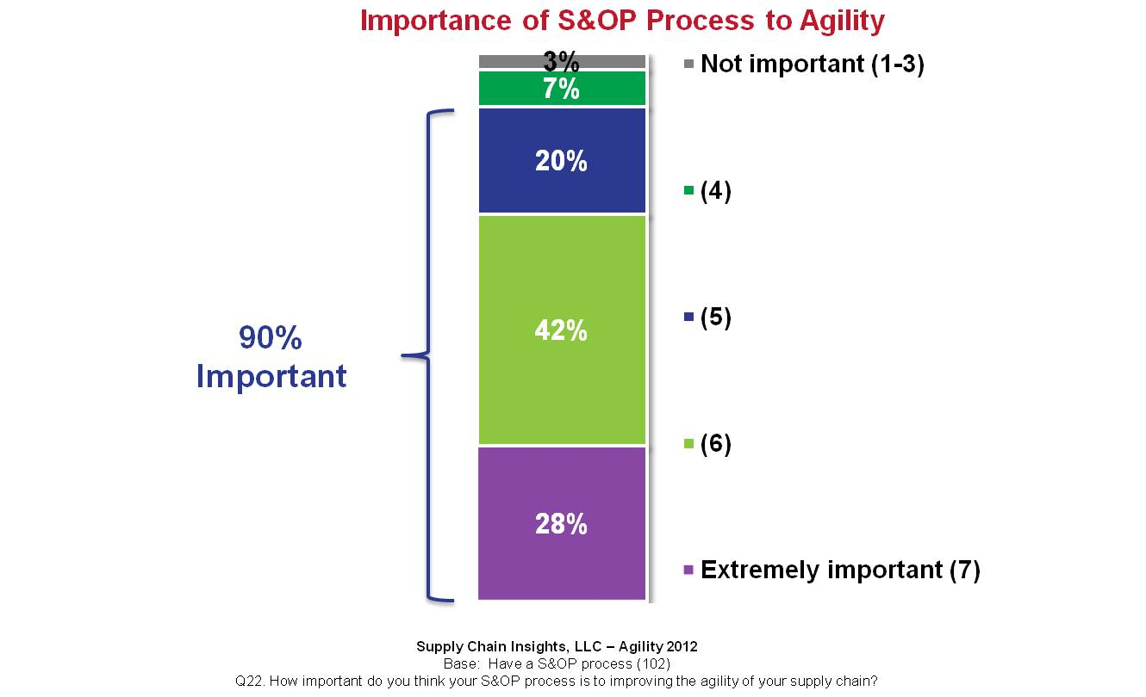
Importance of S&OP Process for Agility

Slide 22
S&OP Plan Execution

Slide 23
S&OP Technology Existence & Functions

Slide 24
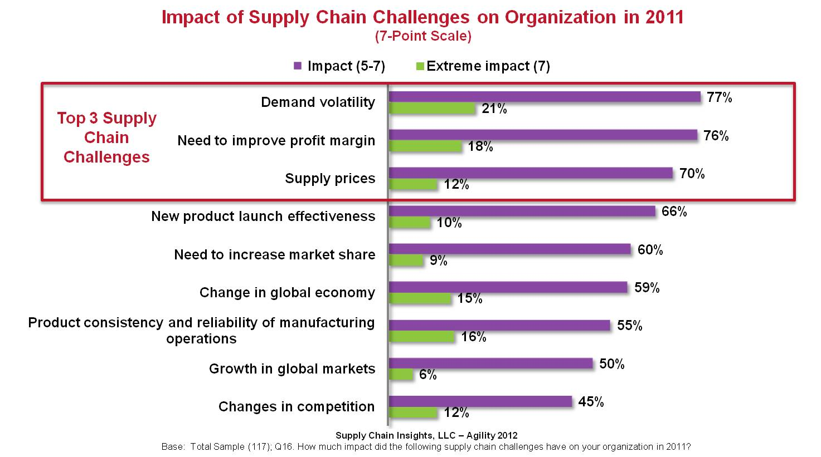
Impact of Supply Chain Challenges

Slide 25
Agenda
Overview
Demographics
Agility Definition
S&OP Process
Agility Performance

Slide 26
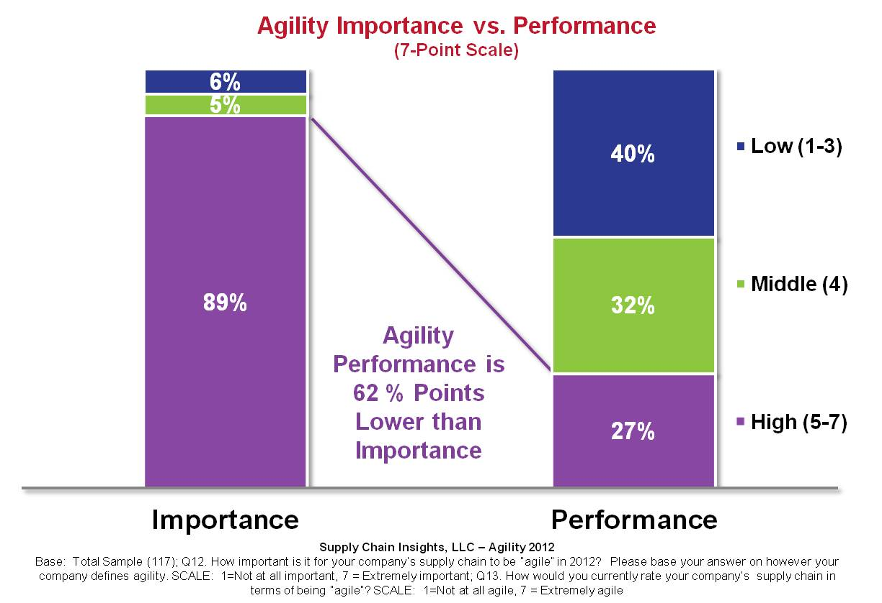
Agility Importance vs. Performance

Slide 27
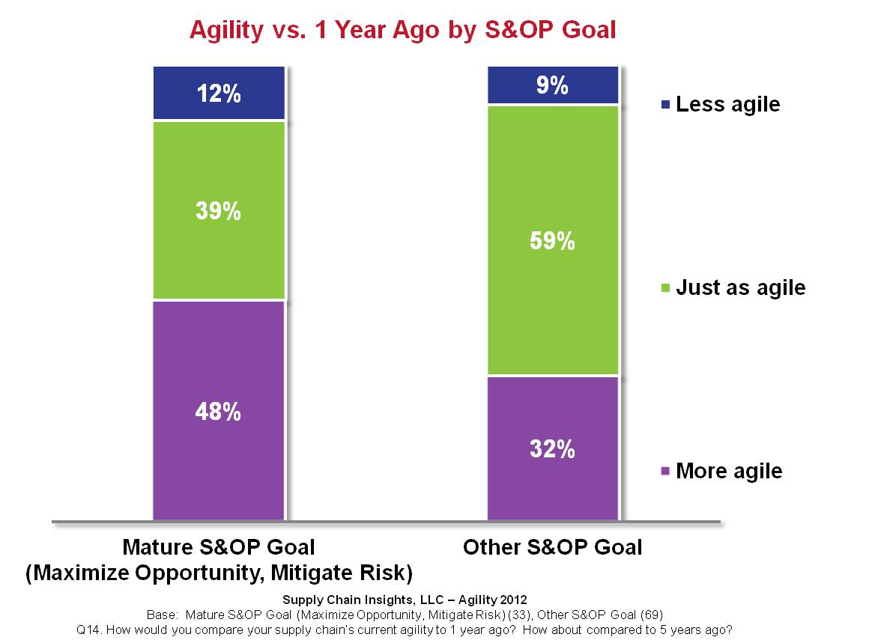
Agility Today vs. Past By S&OP Goal

Slide 28
Agility Techniques

Slide 29
Top 5 Agility Techniques By Agility Definition

Slide 30
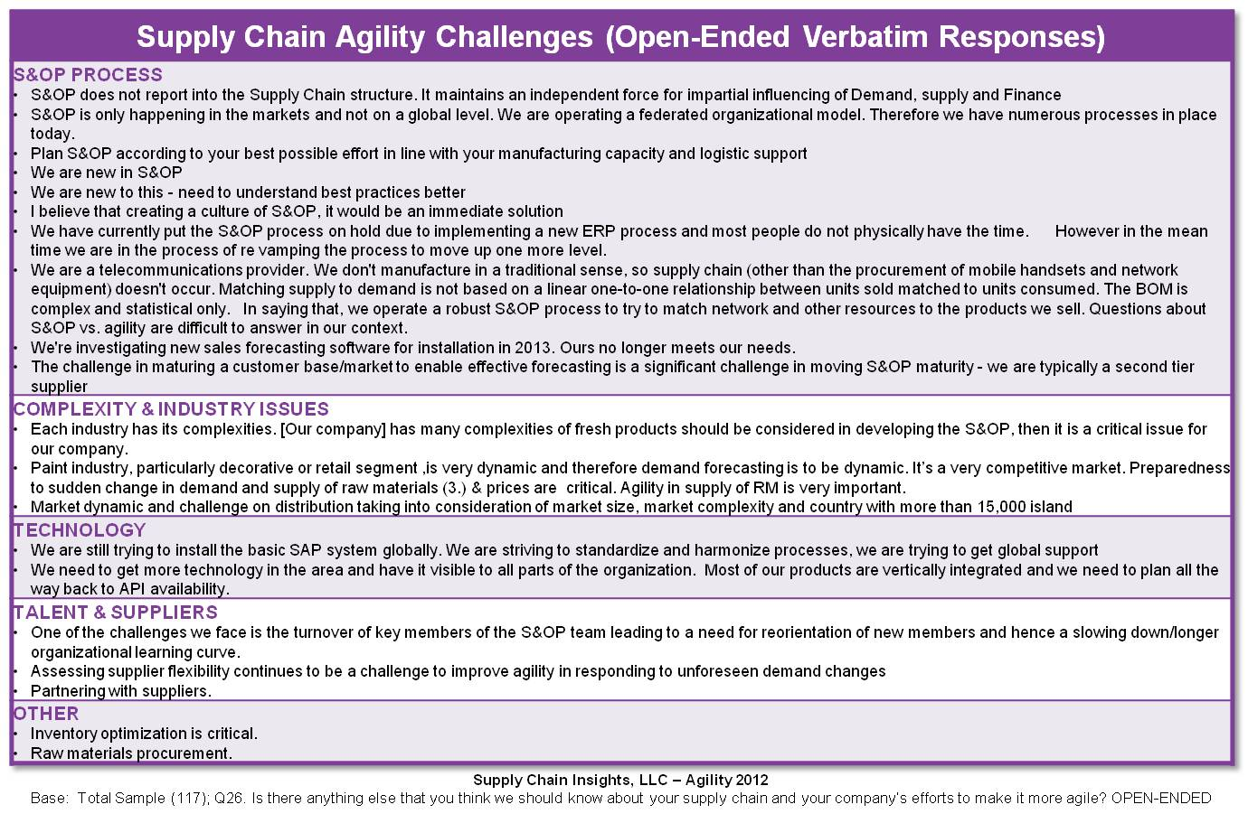
Agility Challenges & Efforts

Slide 31
Key Findings
S&OP landscapes are more complex. The average company has five S&OP processes.
There is a gap in supply chain agility performance.
Companies that are the most mature in S&OP are more agile.
90% of companies believe that a mature S&OP improves agility.
Only 13% of companies have effectively tied S&OP planning to execution.

Slide 32
Who is Lora?
Founder of Supply Chain Insights
Partner at Altimeter Group (leader in open research)
7 years of Management Experience leading Analyst Teams at Gartner and AMR Research
8 years Experience in Marketing and Selling Supply Chain Software at Descartes Systems Group and Manugistics (now JDA)
15 Years Leading teams in Manufacturing and Distribution operations for Clorox, Kraft/General Foods, Nestle/Dreyers Grand Ice Cream and Procter & Gamble.

Slide 33
Where do you find Lora?
Contact Information: loracecere@gmail.com
Blog: www.supplychainshaman.com (3500 pageviews/month)
Twitter: lcecere 2900 followers. Rated as the top rated supply chain social network user.
Linkedin: linkedin.com/pub/lora-cecere/0/196/573 (2300 in the network)

